Slide 1
Ghana’s Popular Tourist Sites Website
Student: Felix Boaroog Atobiga
Course: Introduction to CS Hybrid
Location: Munich
Date: 12th June 2023
We use tech to connect human potential and
opportunity with dignity & humility

Slide 2
What is Website about and what is it meant to serve?
The tourist sites categorised according to the different landscapes and landmarks/features.
Where to search for and book accommodation.
Tourist Guides
Other services such as car rental and logistics
To serve as a one-stop shop providing multiple services to clients.

Slide 3
Why I undertook this project?
My personal experience
Convenience and efficiency

Slide 4
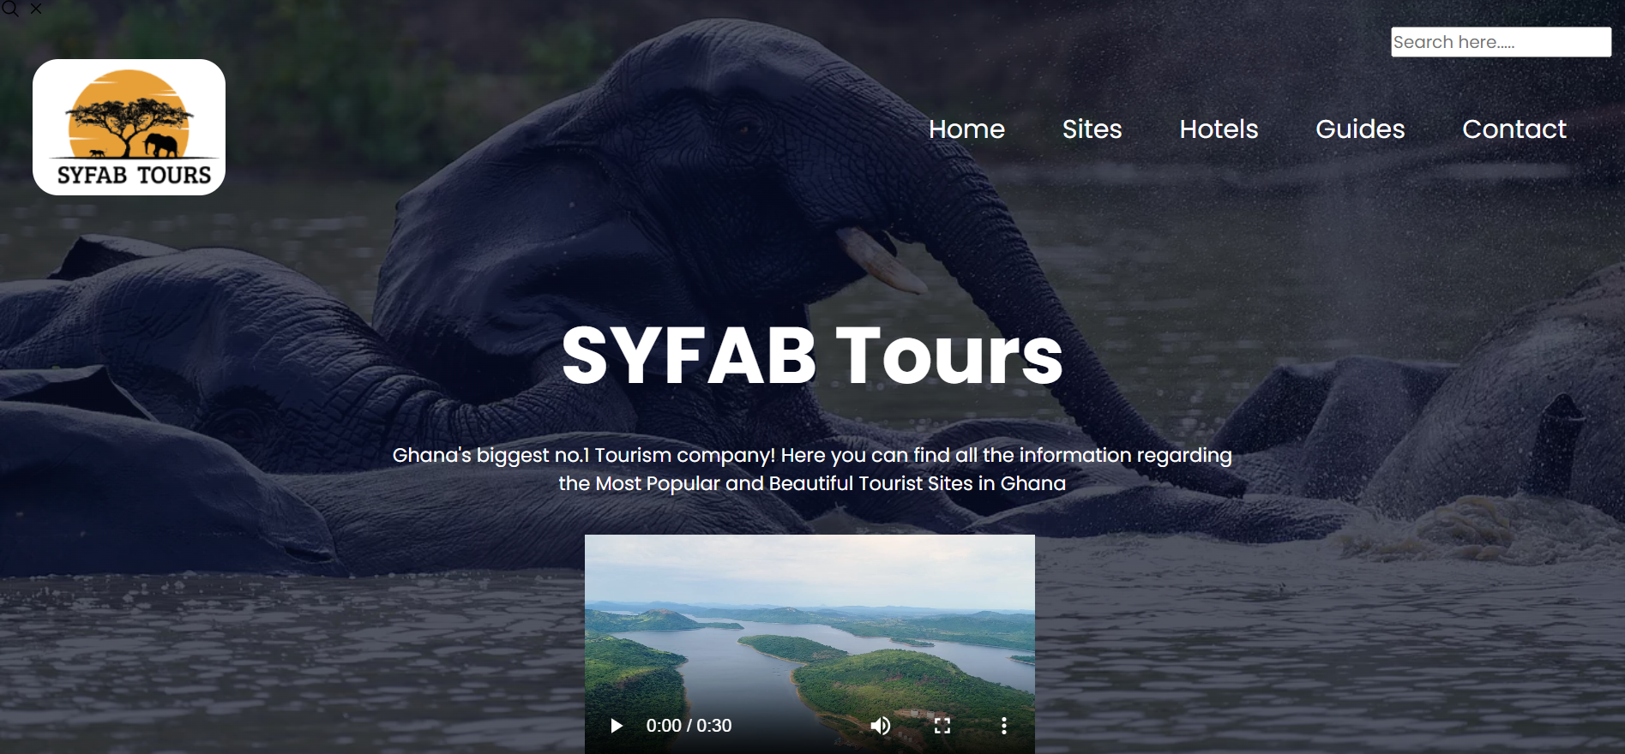
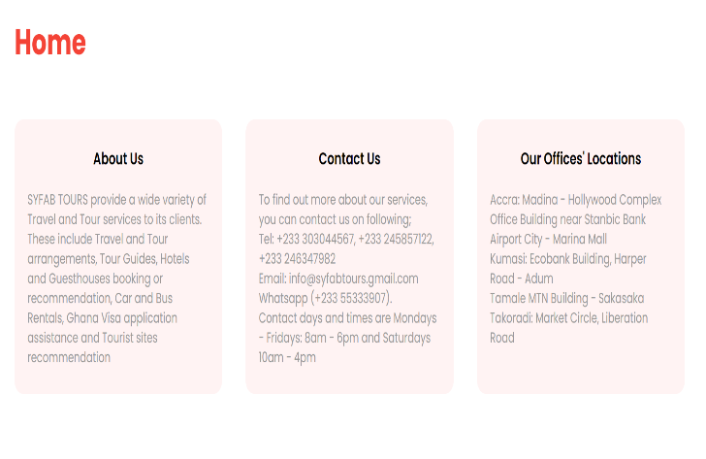
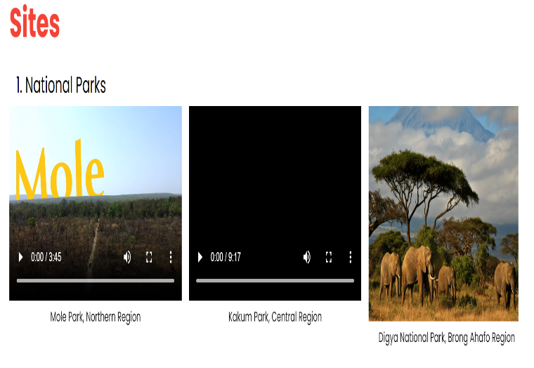
Snapshot of how the website looks

Slide 5
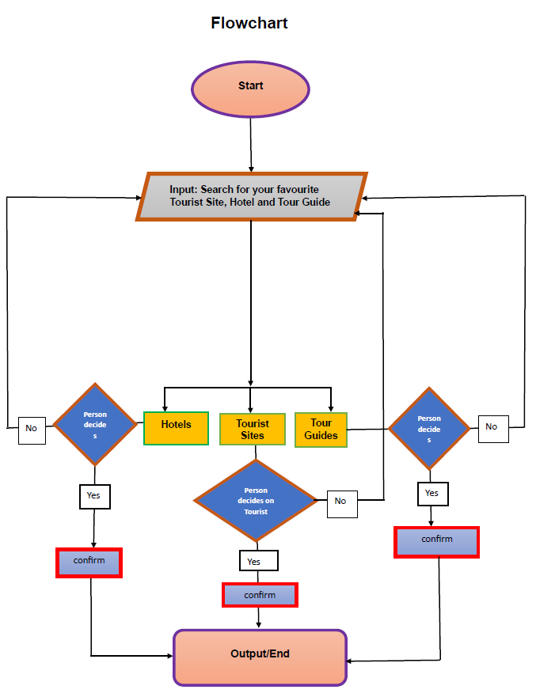
Flowchart

Slide 6
Tools used
HTML
CSS

Slide 7
Challenges and Future steps
Difficulty in incorporating JavaScript.
Unable to make it fully responsive as initially planned.

Slide 8
Thank you for your attention!

